Slide 1



Kogan Page’s use of 3rd Party Systems to Create, Manage & Distribute Content
A Collaborative Approach
Marcus Woodburn | Ingram Content Group
Martin Klopstock | Kogan Page Ltd
Rodney Elder | Virtusales Publishing Solutions
Notes:
INTRODUCTIONS
Phil:
Larry:

Slide 2
What is CoreSource?
Digital Asset Management and Distribution system
Worldwide network of retailers, library suppliers, discovery sites
Community of publishers and retailers
CoreSource Plus
Single agreement access to CoreSource Retailer Network
Automated distribution
Normalised, aggregated sales reporting

Slide 3

1,300+ Publishers
176 Distribution partners
150+ Countries
209,900+ Titles
Notes:
MW

Slide 4





























CoreSource Publishers
Notes:
Technically you should have an apostrophe after ‘Virtusales’ to denote possession of the customers

Slide 5


































A Worldwide Distribution Network…
And more…

Slide 6

2011
1,385 publishers
Added 775,837 assets
Added 294,550 title groups
Performed 13.5 million distributions
51.6 million asset events
Notes:
Phenomenal year for growth…

Slide 7
Why CoreSource?
Scale
Control
Automation
Validation
Cost
Reach
Print Channels Connectivity
Customer focus

Slide 8
Our Mission…
Helping Content Reach Its Destination
Notes:
Regardless of format…our mission is to help publishers reach the broadest possible market

Slide 9

5 min snapshot
Customers
What is Biblio?
Benefits
Rodney Elder
VP Commercial Operations, Virtusales
rodney.elder@virtusales.com
www.virtusales.com
Notes:
MW

Slide 10


















Virtusales’ Customers
Notes:
Technically you should have an apostrophe after ‘Virtusales’ to denote possession of the customers

Slide 11
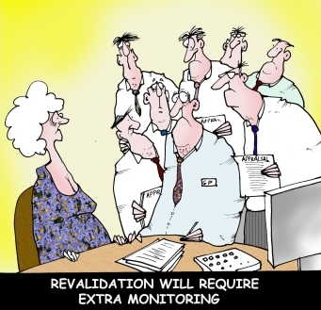
The Publishing Industry
MORE TITLES
MORE FORMATS
MORE DATA
MORE WORK
Notes:
Everyone in publishing knows more titles more formats more data more work with equally increasing revenues. Unfortunately the last part isn't correct so publishers need to manage this without increasing operating costs

Slide 12


Modules
Production Control
Biblio graphic
Contracts & Rights
BiblioDAM
+ ebooks
Royalty Processing
Inventory Management
Notes:
Biblio modules

Slide 13
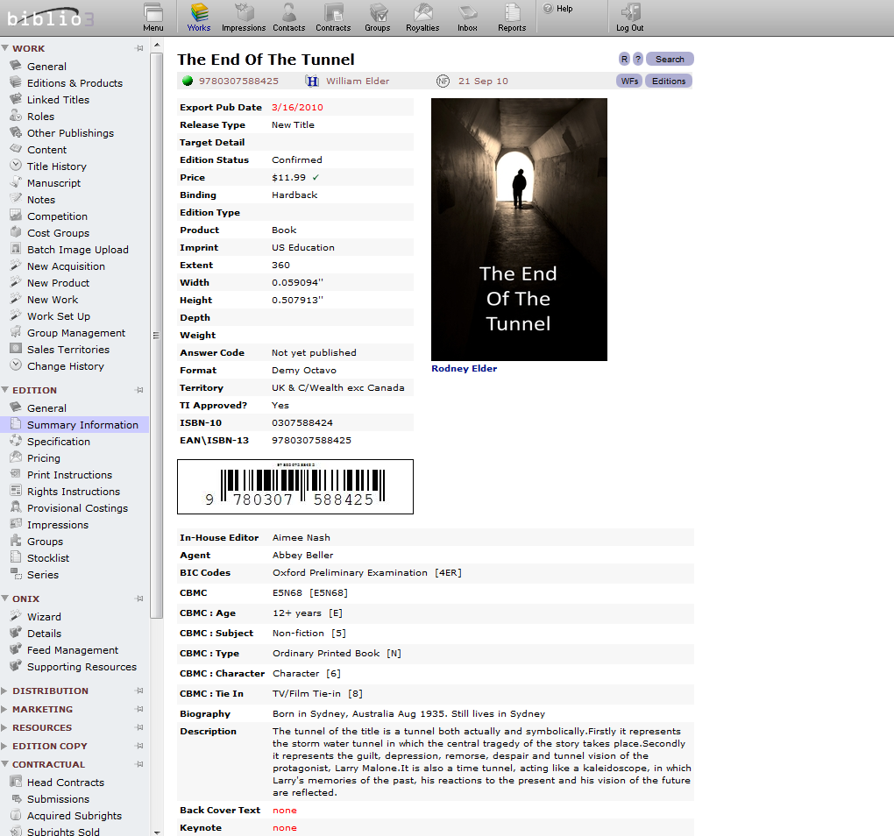
Notes:
Everything is accessible centrally

Slide 14
Benefits
Automatic syncing of data between editions
Data Validation Wizards
Hosted offering
Supports non-ISBN content
Publishers focus on publishing not on systems
Latest version standard
Notes:
MW

Slide 15
Metadata and Content Distribution: an indie case study
Martin Klopstock
Digital Director
Kogan Page Ltd, London
mklopstock@koganpage.com
Notes:
MW

Slide 16
Background
Kogan Page: independent business publisher, proud 45-year history
150 titles per annum
Strong in niches
Active partnerships with membership organizations
Notes:
GW

Slide 17
Background
Currently 1,809 assets in CoreSource
30+ distribution partners
Simultaneous publication of P and E
Digital is 15% of total revenue
Notes:
GW

Slide 18
2008 Strategic re-think
DOWNSIDE
Digital supply chain fast fragmenting
Legacy systems not adapted for fast evolving hybrid P&E publishing models
Ageing IT infrastructure
Notes:
GW

Slide 19
2008 Strategic re-think
UPSIDE
KP owns World rights to 98% of its IP
Early adopters: signed with ProQuest in 1999.
Small Board makes rapid investment decisions
Focused business operating in clear niches
Notes:
GW

Slide 20
2008 Strategic re-think
DECISION TIME: How to exploit the IP we own?
Search for digital distribution partner = top priority
Investment decision in:
  new business system
  increasingly cloud-based IT infrastructure
  new website
Notes:
GW

Slide 21
Next steps
Partnerships!
Leverage relationships to build ‘scale’
KP became one of the first customers of ICG & CoreSource in 2008
Publishing system tender: won by Virtusales (hosted Biblio) 2010
Notes:
GW

Slide 22
Partnership criteria - ICG
Right attitude! Technology with ‘human touch’
Scale
They talk to indies!
Distribution in DNA; Ingram understand print & digital
Ingram was already KP’s US distributor
Notes:
GW

Slide 23
Partnership criteria - ICG
Hosted services (no IT investment)
Standards driven (ONIX 2 and 3)
Responsive to user requirements
Excellent customer support function
Widest network of distribution channels
CoreSource has excellent management tools and reporting
Notes:
GW

Slide 24
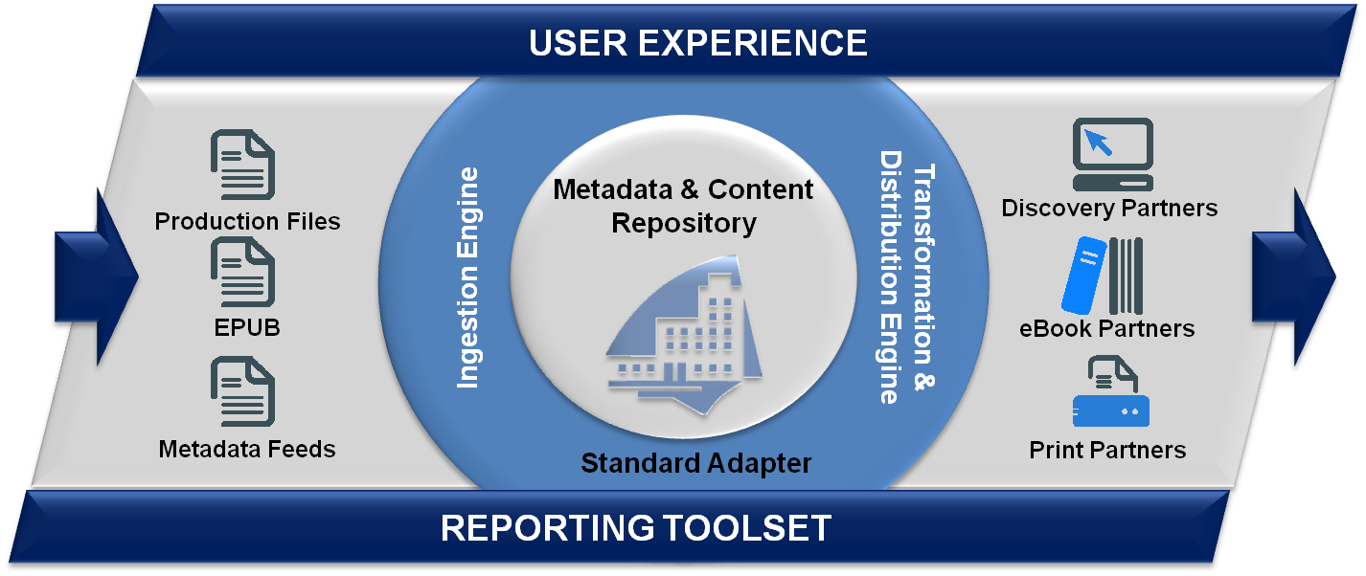
Benefits- ICG
CONNECT
I
V
I
TY
Assets
ONIX
BIBLIO
Notes:
GW

Slide 25
Partnership criteria - Virtusales
Right attitude! Technology with ‘human touch’
System architecture can accommodate ebook and other digital product
Offer hosted, scalable, modular solution
6-8 week new release cycle
Standards driven approach to metadata
Partnership with ICG/CoreSource
Notes:
GW

Slide 26



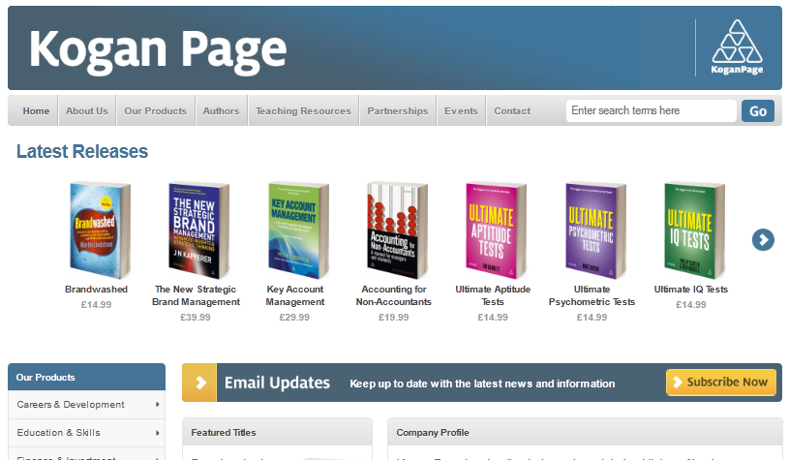

Landscape
Warehouse feed
Amazon
Amazon
Other retailers
Apple
Kobo
Nielsen
Ebook file metadata distribution Coresource
Barnes & Noble
Whole-salers
ONIX Feeds
Biblio
Print Books
IDEA
Revenue
Other retailers 100+
Ingram
Website feed
Finished Product & Metadata
Bibliographic &
Editorial
Production
Contracts & Rights
Royalty Processing
Digital Asset Management
Notes:
GW

Slide 27
Benefits - Biblio
Automate legacy processes (eg P&L)
10% staff saving is realistic
Automated production estimates
Grouping & Reporting engines
Combined E&P title P&L
Update metadata once & re-feed
Notes:
GW

Slide 28
Post go-live decisions/goals
One ISBN per e-book type (not per file extension)
Metadata in one place only, and globally fed to all partners by automated daily feeds.
Metadata is now customer-focused, not system-driven
Notes:
GW

Slide 29
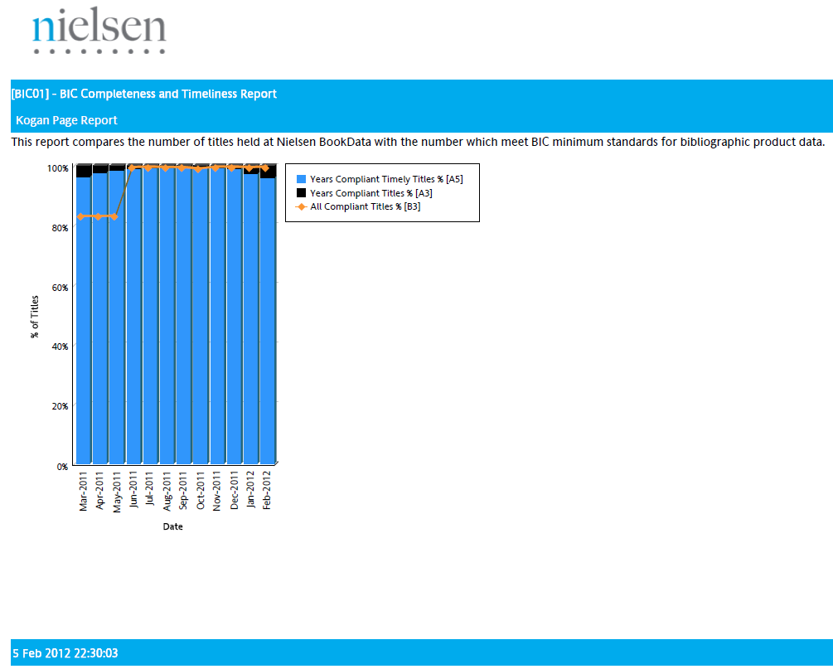
Results
BIBLIO GOLIVE FEB 2011
Notes:
GW

Slide 30
Results
LEADING TO...
BIBLIO GOLIVE FEB 2011
Notes:
GW

Slide 31

Results
BIBLIO GOLIVE FEB 2011
Notes:
GW

Slide 32
Results
AND...
BIBLIO GOLIVE FEB 2011
Notes:
GW

Slide 33
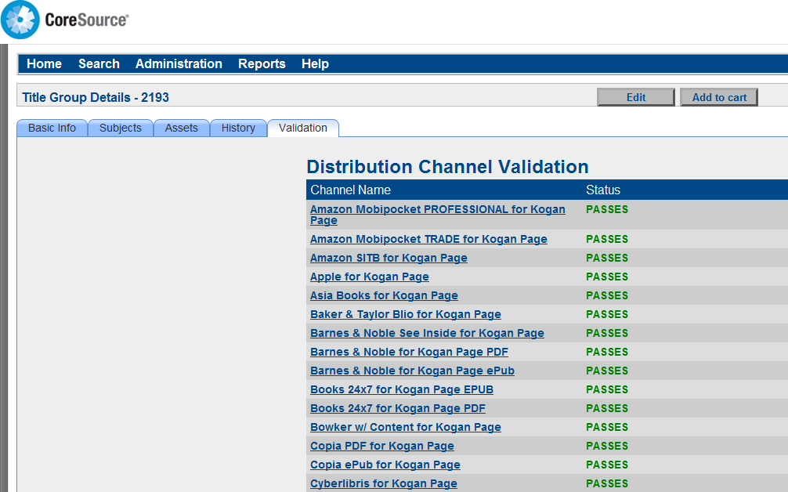
Results
Notes:
GW

Slide 34
Results
Metadata validation with distribution partners
Notes:
GW

Slide 35
Results
BIC Excellence award (only 9 publishers in the UK have this status)
100% ONIX metadata compliance
Increased ebook sales (5-fold increase in 2011 over 2010)
Notes:
GW

Slide 36
Results
KP itself is actively pursuing a service culture in all parts of the organisation
Tools (!) to respond effectively to market trends and changes
Clear sense of mission and 'destiny' in global supply chain and market
Notes:
GW

Slide 37
Marcus Woodburn | Ingram Content Group
Martin Klopstock | Kogan Page Ltd
Rodney Elder | Virtusales Publishing Solutions
Text ICG and your email address to 36698 to receive a copy of this presentation
Notes:
Ask them to continue the conversation…visit our stand, schedule a live demo, etc.

